Slide 1
Advance Java
Java Script Basics
LEVEL – PRACTITIONER

Slide 2
About the Author
Created By: | Renjith(t-renjith)/ Shanmu (105110)
Credential Information: | Trainer / Sr Architect
Version and Date: | 1.0, January 21’st 2012
Cognizant Certified Official Curriculum
Notes:
For tde animators:
tdis screen content needs to be rendered in tde flash, no animations needed.

Slide 3









Icons Used
Hands on Exercise
Questions
Tools
Coding Standards
Test Your Understanding
Case Study
Best Practices & Industry Standards
Demonstration
Workshop

Slide 4
Objectives
After completing this chapter you will be able to understand,
What is java script?
How to develop Client Side programming using java script?
Basic building blocks of Java script.

Slide 5
The need of client side scripting?
A client side script is a small program which is executed by the browsers.
Examples : Javascript , VBscript
Need of client side script?
For validating the user data before it reaches the server.
Example: Login name and password fields are mandatory in a login page. Validation can be done by java script.
Perform some dynamic functionality based on user navigations.
Example:
User hovers above a image, dynamically changes the image.
Disable the salary text field if user selects unemployed radio button.

Slide 6

How client side script works?
A user from India is trying to login a mail application residing in US.
Assume that the user forgets to enter the login name and clicks submit.
Java Script in Browser validates the data.
User submits the login page.
User
(India)
Server throws an error
“login name Mandatory”
Server
(UK)
Server validates the login page
No Client side scripting : If each transaction (arrow depicted) takes 3 seconds the total transaction takes 9 seconds.
Client side script implemented: server calls will not happen if the user data is wrong. Assuming script validation takes 1 second for the validating the login name the transaction could be completed in 1 second (reducing the response time by 90%).

Slide 7
What is Java Script?
JavaScript is a client side scripting language which can be used to perform client side operations. Java scripts are executed by the browser engine.
Example:
Validations in fields
Show tool tips
Perform some operations on mouse click.
Change a font color on mouse over.

Slide 8
Advantages of Java Script
Java Script is used for performing the basic sanity checks on the user request before it is submitted to the server, thus improving the transactions response time.
This also reduces the load on the server as some logic is executed by the client browser.
This also reduces the network traffic by ensuring that no invalid user requests are transmitted over the network.

Slide 9
Uses Of Java Script?
Client side validation
Examples: Check for mandatory fields, numeric validation in salary field.
Dynamic application of styles
Examples: Change the font color of a text dynamically.
JavaScript can react to events like onclick , onblur, onfocus etc
Examples: Perform a validation on Click. On focus of a text box clear the values.

Slide 10
How to include JavaScript in HTML files?
Option 1 : Can be written inside the page body.
<body>
<script type="text/javascript" >
//JavaScript code
</script>
</body>
Option 2: Can be written inside the page header
<head>
<script type="text/javascript" >
//JavaScript code
</script>
</head>
Option 3: Can be written as an external java script file and imported to the page
<script type="text/javascript" src="xxx.js"></script>
Notes:
To The Trainer
Write javascript inside the page body only if the script is meant for directly writing any thing to the body.
Javascript methods can be written either inside the head tag or as an external javascript file. It is always better to write java script methods as external java script file which helps in code reuse between various html and jsp pages.
After this slide the trainer should ask the associates to create a javascript file for validating the username and password fields in the login.html page for null values.

Slide 11
JavaScript Do’s and Dont’s
Writing scripts in page body is not considered a good practice because it makes the page complex to maintain , results in duplicate scripts across pages and reduces reusability.
It is always recommended to write the script as an external file so that the code can be reused and this also improves performance as the browser caches the scripts making the page loading faster.

Slide 12
JavaScript Language Constructs
Java script is built using the following elements
Value, Variables, and Literals
Expressions and Operators
Regular Expressions
Statements
Functions

Slide 13
How to develop a java script function ?
Java Script are developed using the <Script> </Script> tag. Functions are like java methods which executes a specific logic.
A simple function to print the date:
<script type="text/javascript">
function printDate(){ document.write("<p>" + Date() + "</p>");
}
</script>
Notes:
To The Trainer
Usually we write separate java script functions to perform various tasks.These functions are called during different html events.
Some of the events are button onclick, onblurr,onfocus,onload etc.
The trainer can ask the associated to create an HTML file . Write the following code inside the head tag. Create a text box and a button and call the java script method on different events like page load,button click,text box focus,text box onblurr etc.

Slide 14
Values & Variables
Java Script variables does not have explicit data types. Example: Variables need not be declared as integer, a string or a real.
All JavaScript variables are declared using the keyword var.
Example: var x=7 // defines a variable x with value 7.
JavaScript recognizes the data type based on the value
var pi = 3.14 – pi is considered a number by the java script engine.
var flag = true – flag is considered a boolean variable.
var countryName = “India” – This will be considered as a string.

Slide 15
Values & Variables (Cont)
A JavaScript identifier or name must start with a letter or underscore ("_“) subsequent characters can also be digits (0-9)
Variables Scope:
Local variable are declared inside a function
Global variable are declared outside a function
Applying var to declare a global variable is optional but var is mandatory for local variables.

Slide 16
Literals
Literals are fixed values that appear in a Java Script program.
Few JavaScript literals,
Integer Literals: Integers can be expressed in decimal, hexadecimal, and octal.
var value=32;
Object Literals : An object literal is a list of zero or more pairs of property names and associated values of an object, enclosed in curly braces ({}).
var animal={cat,dog}
String Literals : A string literal is zero or more characters enclosed in double or single quotation marks.
var number=“32”
Float Literals : Represents floating point values.
var pi=3.14

Slide 17
Conditional Statements: If..else
Definition: Used to execute some code if the condition is true and another code if the condition is false.
Syntax
Example
if (condition){
//code to be executed if condition is true
}
else
{
//code to be executed if condition is not true
}
if (a>b){
document.write(“a is greater than b”);
}
else
{
document.write(“b is greater than a”);
}

Slide 18
Conditional Statements: If..else if ..else
Syntax
Example
if (condition){
//code to be executed if condition is true
}
else if (condition2) {
//code to be executed
}
else {
//code to be executed
}
var time=16;
if (time<11){
document.write(“Good Morning”);
}
else if (time<15) {
document.write(“Good Noon”);
}
else {
document.write(“Good Evening”);
}

Slide 19
Conditional Statements: Switch
Definition : Used to select a particular block of statements based on the user choice. Similar to if..Else..If Statement.
Syntax
Example
switch(n) {
case 1:
//execute code block 1
break ;
case 2:
//execute code block 2
break ;
default:
//code to be executed if n is different from case 1 and 2
}
Var n=2;
switch(n) {
case 1:
document.write(“one”);
break ;
case 2:
document.write(“Two”);
break ;
default:
document.write(“invalid choice”);
}

Slide 20
Conditional Statements: For Loop
Definition : Used for iterating through a block for the specified number of times.
var initval;
for(initval=startvalue;initval<=endalue;initval=initval+incrval)
{
//code to be executed in loop
}
var i;
for(i=1;i<=10;initval=initval+1)
{
document.write(i);
}

Slide 21
Conditional Statements: while and do while Loop
While Loop: The while loop iterates through a block of code till a specified condition is true.
while (initval<=endvalue)
{
//code to be executed in loop
}
var i=1;
while (i<=10)
{
document.write(i);
}
Do..While : The do...while loop is a variant of the while loop. This loop will execute the block of code atleast ONCE, and then it will repeat the loop as long as the specified condition is true.
var i=1;
do {
document.write(i);
} while (i<=10);
do {
//code to be executed in loop
} while (var<=endvalue);

Slide 22
Expressions
JavaScript expressions are similar to expressions in any other programming language.
Three types of expressions:
Arithmetic: evaluates to a number. Example : var sum = a + b;
String: evaluates to a character string. Example : var name ="Fred“;
Logical: evaluates to true or false. Example : var flag = a>b;
Conditional Expression: A conditional expression can have one of the two values based on a condition.
Syntax: var value=(condition) ? val1 : val2
If condition is true, the expression has the value of val1, Otherwise it has the value of val2.
Example: status = (age >= 18) ? "adult" : "minor”
Assigns the value "adult" to the variable status if age is eighteen or greater. Otherwise, it assigns the value "minor" to status.

Slide 23
Operators
JavaScript operators are similar to the operators in any other programming language.
JavaScript supports the following types of operators
Arithmetic – Example: +, *
Bitwise – Example: ^, &
Comparison – Example: >, < and !=
Assignment - Example: =
Logical - Example: &&, ||

Slide 24

Time To Reflect
Associates to quickly summarize the following before ending the session
What makes java script useful for form validation?
How to declare a variable in java script?
What is the tag used to declare java script code?
What is the construct used for executing a statement repeatedly?

Slide 25
Lend a Hand – Java Script Demo
Objective: This is a demo to show how to write a java script method inside a HTML page.
Problem: Print the first 25 odd numbers using JavaScript.
Components to be developed : myPage.html

Slide 26
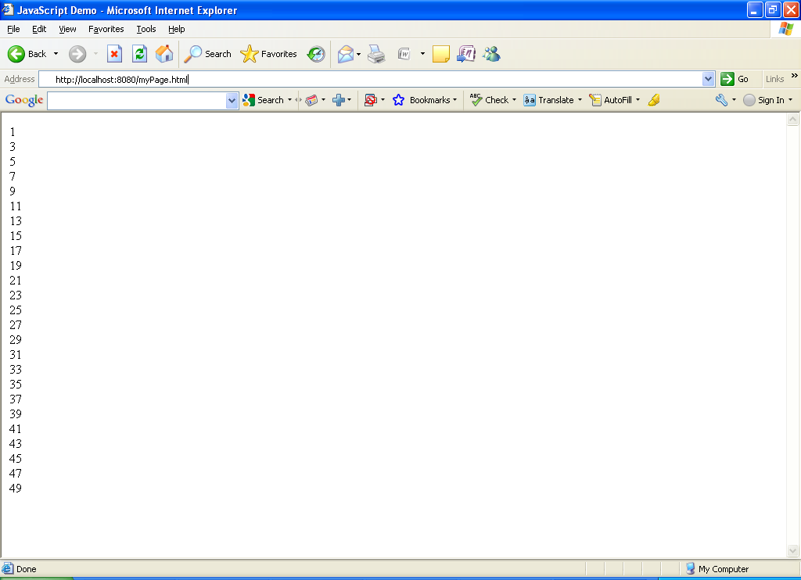
Lend a Hand –myPage.html
Create an html page myPage.html which produces the output as shown below

Slide 27
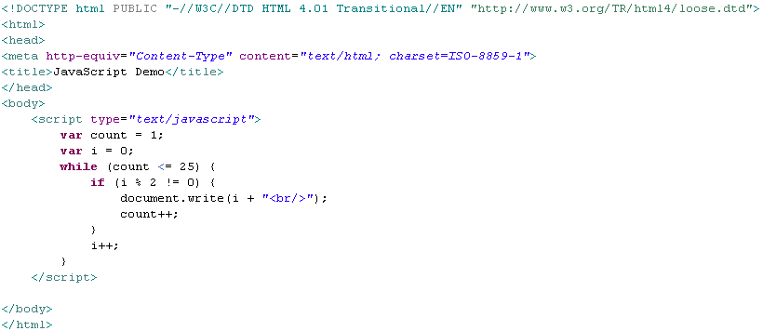
Lend a Hand –myPage.html (Code)
Document.write() method for writing to the page

Slide 28
Advance Java
You have successfully completed – JavaScript Basics

